Slide 1

Agile Talks
Welcome
2013-03-20
sergiotaborda@zbra.com.br

Slide 2
Agile Talks
Inception (Sérgio)
Origin of Agile
Principles of Agile
Planning (Sérgio)
Planning Concepts
Practices Workshop (next week)
Engineering (Fábio)
Agile Engineering
Agile Engineering Workshop

Slide 3
Agile Talks
Inception
2013-03-20
sergiotaborda@zbra.com.br

Slide 4
Contents
Part I - Origins
All things Agile
Insights
What Agile Is
What Agile Is Not
Part II – Planning
Project Dimensions
The Product Owner and the Product Team
Elicitation and Grooming
Size Estimation and the Planning Poker
Stories, Tasks and Burndown
Reviews

Slide 5
Part II
Agile Origins

Slide 6
All Things Agile
Agile
Engineering
Practices
Pair Programing
Refactoring
Test Driven Development
Unit Testing
Coding Standards
Continuous Integration
Agile Modeling
Feature Driven Development
Shared Code Ownership
Integration Testing
Design Patterns
Document Late
Behavior
Driven Development

Slide 7
All Things Agile
XP
Unified Process
Scrum
Lean
Agile Unified Process
Agile Engineering
Practices
Rational Unified Process
Kanban
Adaptative Software Development
Crystal
Waterfall
Clearroom
TSP/PSP

Slide 8
199: Jeff de Luca devised Feature Driven Development with further development by Peter Coad and Jon Kern
2000: Robert “Uncle Bob” Martin starts organizing the reunion at “The Lodge”
1995: The CHAOS report is published
1957: Geral M Weinber “Iterative and Incremental Development: A Brief History”
1994: Jim Coplien remarks that Daily Meetings leads to Hyperproductiviity
2002: Scrum community introduces measure of Velocity
1995: Larry Constantine talks about “Dynamic Duos”
1956:Herbert D. Benington introduces the Waterfall model
2002: Kent Beck creates Test Driven Design
1995: Jim Coplien defines Pair Programming
1990: Toyota creates Lean Manufacturing Process
2002 James Grenning porposes Planning Poker
1995: Jeff Sutherland and Ken Schwaber develop Scrum
1950
1960
1970
1980
1990
2000
2010
1970 : E. A. Edmonds introduced an adaptive software development process
1992: Alistair Cockburn develops Crystal Methods
2009: Software Craftsmanship Manifesto is born
1970 : Barry Boehm proposes Wideband Delphi
2008: The concept of Definition of Ready is introduced in the Scrum community
2003 Mary and Tom Poppendieck create Lean Software Development
1999: Jim Hightsmith creates Adaptive Software Development targeting RAD development
1986:: Takeuchi and Nonaka use the term Scrum for the first time
1986: Barry Boehm proposes Spiral Model of Software Development
1999: Andrew Hunt publishes “Pragmatic Programmer”
1988: Scott Schultz indtroduces de Timebox concept
1999: Kent Beck creates Extreme Programming
2001: The Agile Manifesto is born
1989: Ward Cunningham describes de CRC technique
1999: Martin Fowler conceptualizes Continuous Integration
Notes:
The older reference to something agile like originated in 1957 with Gerald M. Weinberg, as quoted ( in Larman, Craig; Basili, Victor R. (June 2003). "Iterative and Incremental Development: A Brief History“ (http://en.wikipedia.org/wiki/Agile_software_development)
Time lines at http://setandbma.wordpress.com/2012/03/23/agile-history/
http://guide.agilealliance.org/timeline.html
http://prezi.com/am04ulpcipyt/scrumfluenca/

Slide 9
Agile is not a Manifest
Manifest
Principles
Individuals and interactions over Processes and tools
Working software over Comprehensive documentation
Customer collaboration over Contract negotiation
Responding to change over Following a plan
Our highest priority is to satisfy the customer through early and continuous delivery of valuable software.
Welcome changing requirements, even late in development
Working software is delivered frequently
Business people and developers must work together daily throughout the project.
Build projects around motivated individuals. Give them the environment and support they need, and trust them to get the job done.
The most efficient and effective method of conveying information to and within a development team is face-to-face conversation.
Working software is the primary measure of progress.
Agile processes promote sustainable development. The sponsors, developers, and users should be able to maintain a constant pace indefinitely.
Continuous attention to technical excellence and good design enhances agility.
Simplicity--the art of maximizing the amount of work not done--is essential.
The best architectures, requirements, and designs emerge from self-organizing teams.
At regular intervals, the team reflects on how to become more effective, then tunes and adjusts its behavior accordingly.

Slide 10
Insights
A waterfall process is ill-suited for common software development
Requires a cyclic process
Requires an iterative process
Software is not like building a bridge
Does not rely on predictive rules
Requires an adaptive process
People are not drones
Building Software is an intellectual endeavor
Face-to-Face Communication works best

Slide 11
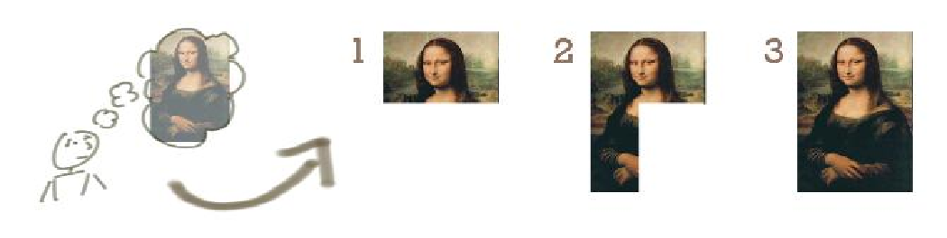
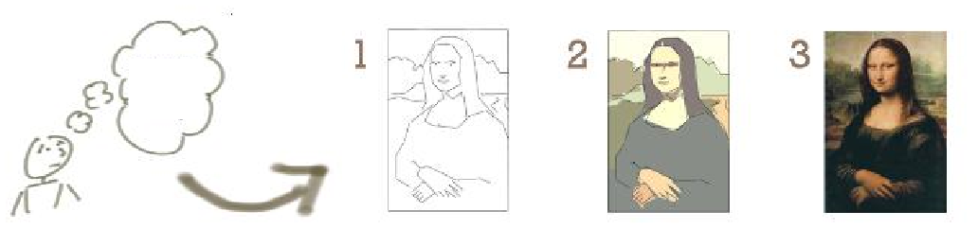
Iterative vs Incremental
Incremental
Iterative

Slide 12
Incremental
Each step is not deliverable as the value in the whole
If money runs out , nothing is usable
The customer forces termination by any means necessary

Slide 13
Iterative
Each step is deliverable with different value
Each step is deliverable with different, increasing, value
If money runs out , a simpler version will run
The customer has return over investiment at any point

Slide 14
Software is a Product
Project
Product
Is Limited in Time
Money runs out
Interest runs out
Oportunity phases out
Short Term Objectives
Objectives do not change
Responsability
Project Manager
Stearing Comitee
Delegatable
Is Endless
It makes money
Is a brand
Its a payed investment
Long Term Objectives
Objectives will change
Responsability
Product Departament
Marketing
Finance
Not Delegatable

Slide 15
Software is a Product
Evolution needs to be controlled by Product Development
In the pivot figure of the Product Owner
Product Owner has responsibility for the features and the results (ROI)
Product Evolution is based on observation of users
Measures to guide decision and not gut feeling
Features not used by users are not features
You are not the user

Slide 16

Traditional View
The Project is the Software and vice versa
The Project will end => The Software will end
Money runs out
Time to Market run out
The Software has components => The project can be split in “phases”
Deliver in “working” parts
We sell a Project/Software and steer a Software/Project
Projects need documentation => Software needs documentation
The customer is always right. Do it.

Slide 17
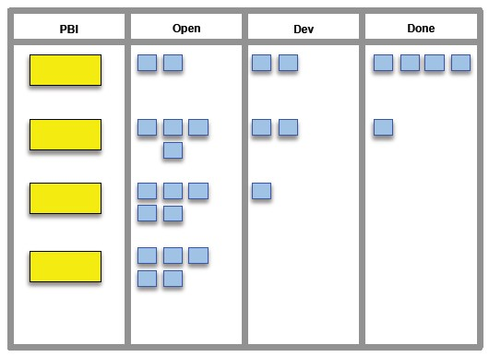
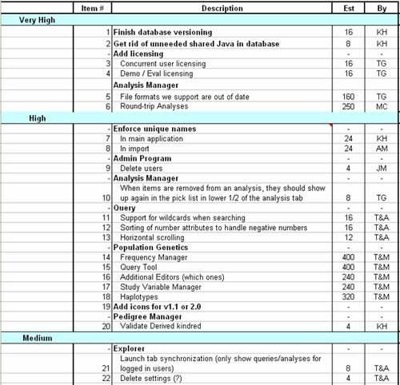
Agile View
The Software is a Product
The Product will never end
Because it makes money
The Project is an endeavor
To implement a part of the software
The endeavor has an end, and can fail, the product doesn’t
We sell a Project and steer a Project
The client steers a Product and ROI
The project needs documentation, not documents
The software needs the documentation the client needs
The customer is not always right, but always has a point. Listen.

Slide 18
The Stage-Gate Process Control
Stage 1
Gate 1
Stage 2
Gate 2
Stage n
Gate n
...
A sequece of stages protected by gates
At a stage actions are performed
At a gate artifacts are controlled. If ok, move to next stage
For Software Stages normally are
Inception, Development, Implementation, Test , Deliver
Stage-Gate Sequence can repeated (Iterative processes)
Waterfall is an Iterative Stage-Gate with 1 iteration (do or die)
(R)UP is and Iterative Stage-Gate with N iterations

Slide 19
Deterministic vs Stochastic
Deterministic
H
B
P(B | A) = 1
A
H
B
Defined
Process
A
Stochastic
H
B
P(B | A) = f(H)
A
H
C
A
Empirical
Process
Notes:
Num processo estocastico o resultado é determinado com uma probabilidade que depende do estado do sistema

Slide 20
The Empirical Process Control
Measure
Adapt
Inspect
Continuous (Not Stage-Gate)
In every action , in every individual (Not comand and control)

Slide 21
People Communicating
Document Late
Documenting may be necessary, but it is produced after the software, not before.
Software guiding documentation, not documentation guiding software
Small Teams
Minimize the N(N-1) /2 Channels Problem (0, 1, 3 , 6 , 10, 15)
Information radiators
Maximize Focus
Remove distractions
Bugs are distractions
Messed code is a distraction
Wrong requirements are a distraction

Slide 22


What Agile Is
Searching
Interacting People
Measure
Technical and Comercial
Using
Tends To
Adapt
Inspect
Empirical Process Control Model

Slide 23
What Agile Is
People making a product
Continuously Measuring
Times - time to deploy, time to boot, time to create feature, time to maintain, etc..
Sizes – size of team, size of scope,
Quality Metrics – size of code, size of modules, number of modules, coupling , dependency, etc...
Satisfaction – users use feature, users like feature, bugs, etc..
Continuously Inspecting
The Quality (what the numbers mean)
The Scope (what to do next)
The Product (the objectives are being accomplished)
The Software (the quality is there? It still works ?)
The Process (is helping or annoying ?)
Continuously Incrementing Value
Deliver Soon
Deliver Often
Deliver something more each time
Continuously Adapt
Change what is not working
Repeat

Slide 24
What Agile Is Not
The Absence of Requirements Elicitation
Can be the absence of all-up-front elicitation
The Absence of Documentation
Can be the absence of most documents (risk management)
Can be the absence of imutable contracts (legal rights)
The Absence of Order
A single process is being followed
Well defined roles and responsabilities
Leissez-Faire
The team is not abandoned
The team is not independent
The team is not responsable for business decisions
Notes:
Leissez-Faire (Deixe Fazer) é um termo da economia que se refere a uma politica liberal em que o mercado deve ser livre de fazer o que quiser desde que não compita com certos direitos alheios (http://pt.wikipedia.org/wiki/Laissez-faire)

Slide 25
Part II
Agile Planning

Slide 26
Project Dimensions
Scope
Quality
Schedule
Cost
Notes:
O triangulo de ferro (Iron Triangle) também conhecido como triângulo de ouro.

Slide 27
Tradicional View
Define Scope, Schedule , Cost
You can optimize two
Assume Quality is given
If you do not trust them, create a Quality Assurance body
Assume the Scope is contractual and all Scope is necessary
Assume Scope will not change
If it does annoy them with Change Requests
Assume Risc is controllable
Create a Stearing Commitee.
Scope
Quality
Schedule
Cost
Notes:
O triangulo de ferro (Iron Triangle) também conhecido como triângulo de ouro.

Slide 28
Project Dimensions
Scope
Risc
Value
Schedule
Cost
Quality
Notes:
6 Project Dimensions (Prince2)

Slide 29
Modern View
Mesure all variables with numbers
Define Schedule, Cost and Quality
Assume Scope will change
Because it will
Because Value will change
Because Business Objectives will change
Risc is controlable if measurable
Adjust Scope acordingly
Scope
Risc
Value
Variable
Fixed
Schedule
Cost
Quality
Notes:
O triangulo de ferro (Iron Triangle) também conhecido como triângulo de ouro.

Slide 30

Tradicional View
Target driven
Target a Cost
Target a Schedule
Target a Scope
Stearing
The target does not move
You cannot go back
You cannot abort
The arrow cannot be moved by the Steering Commitee to another target on demand
Notes:
O triangulo de ferro (Iron Triangle) também conhecido como triângulo de ouro.

Slide 31
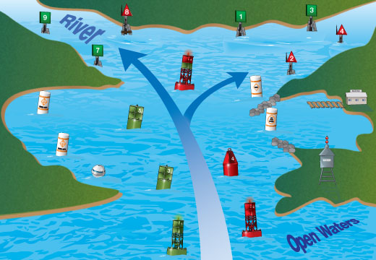
Agile View
Objective driven
Target a Cost
Target a Schedule
Target a Quality
Target an Objective
Navigation
The target does move
You can go back
You can always abort
The boat can be moved by the Steering Commitee to another target on demand

Slide 32
Steering vs Navigating

Slide 33
Dimensions in Agile : Schedule
Define
Releases by Time to Market Dates
Goals for Releases
Dates and Duration of Releases
Number of Sprints in Release
Measure
Story Points per Sprint (Velocity)
Story Points in Release / Minimum Velocity
Review Constantly
Release Backlog Burndown

Slide 34



Software
Software
Project
Release 1 (Version 1.1)
Project A
Sprint 1
Sprint 2
Project B
Sprint 3
Project C
Release 2 (Version 1.2)
Sprint 1
Sprint 2
Sprint 3
Sprint 4

Slide 35
Software
Release 1
Sprint 1
Sprint 2
Sprint 3
Release 2
Sprint 1
Sprint 2
Sprint 3
Sprint 4

Slide 36
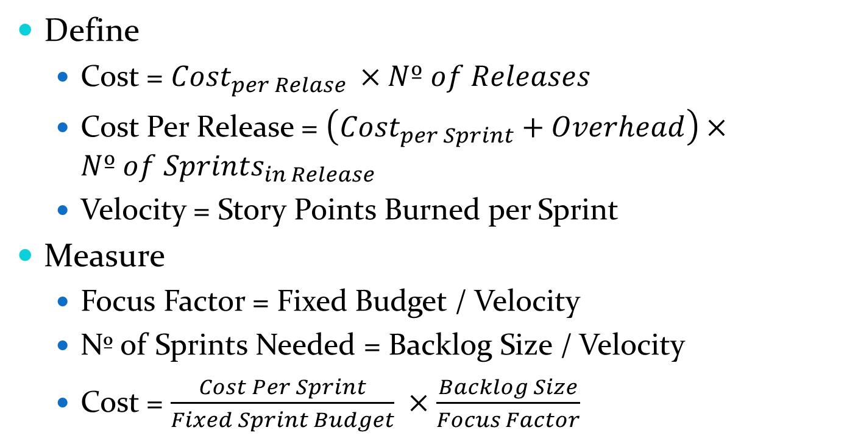
Dimensions in Agile : Cost
Define
Cost = ${Cost}_{per Relase }×Nº of Releases$
Cost Per Release = $\left({Cost}_{per Sprint}+Overhead\right)×Nº of {Sprints}_{in Release}$
Velocity = Story Points Burned per Sprint
Measure
Focus Factor = Fixed Budget / Velocity
Nº of Sprints Needed = Backlog Size / Velocity
Cost = $\frac{Cost Per Sprint}{Fixed Sprint Budget} ×\frac{Backlog Size}{Focus Factor}$
Notes:
Sprints are not immediate one after the other. The overhead is the cost when the sprint is not “on”

Slide 37
Agile Contract
Customer collaboration over contract negotiation
“over” not “instead”
Contract is legally mandatory
“Negotiation” comes from problems with promises made about schedule and scope, that do not exist in agile
Agile Contract
Define an umbrella contract that defines the stakeholders involved and the general rules of engagement
Does not define scope, or time limit
Append “Service Orders” for an appropriated time period (1 Release , 2 Releases, etc..)

Slide 38
Dimensions in Agile : Scope
Define
By Creating Stories
Putting Stories in Backlog
Measure
Size in Story Points
Review Constantly
Priority
Dependency
Value

Slide 39
Defect Backlog
*
Epic / Theme
Story
Defect
*
*
Block
*
Backlog
Impediment
Task
Product Backlog
Impediments
Backlog
Release
Backlog
Sprint
Backlog

Slide 40
Story Taxomony
Identification
Description
Prioridade
Tamanho (SP)
S-123
200
5
As a hotel guest I want to reschedule my reservation, with no extra expense, in order to maintain interest in hotel services
Acceptance
The Guest must be logged in It is not possible to reschedule for a past date
The Guest can only change his reservation
500
Acceptance Criteria
Value

Slide 41
INVEST (in) Ready Stories
I – Independent
One Story must not depend on others (decoupling)
N – Negotiable
Not all stories are necessary
Not all stories are ASAP
V – Valuable
Must improve business ROI
Must benefit the user in some aspect
E – Estimable
Must be possible to estimate its size
S – Small / Simple
As small and simple as possible to help implementation
T – Testable
Must be verifiable by the user
Better if can be automatically, and repeatedly, verified
Notes:
Epics are exceptions to the estimable rule, maily because they are not ready

Slide 42
Story Taxomony
Actor
Goal
Business Value
S-123
200
8
As a hotel guest I want to reschedule my reservation, with no extra expense, in order to maintain interest in hotel services
Acceptance
The Guest must be logged in It is not possible to reschedule for a past date
The Guest can only change his reservation
500
Pre and Pos Conditions + Alternative Paths

Slide 43

Software
Product Backlog
Release Backlog
Release 1
Sprint Backlog
Sprint 1
Sprint Backlog
Sprint 2
Sprint 3
Sprint Backlog
Release 2
Release Backlog
Sprint 1
Sprint Backlog
Sprint 2
Sprint Backlog
Sprint 3
Sprint Backlog
Sprint 4
Sprint Backlog

Slide 44

The Story Size
Size is a new property not found in traditional environments
Size a measure of work
Size is used to estimate of “how big the story is” and not “how long is necessary to implement it”
Size is related to
Definition of “Done”
Needed documentation , quality , etc..
Number of tasks necessary
Difficulty of tasks necessary
Complexity of Business Rules
Size is not a quantity of Risk, nor a quantity of Time

Slide 45
Determine Story Point Meaning
Ideal Day
1 SP = 1 Ideal Day for a Senior Developer
Relative Size
N SP = Size of a Reference story or story group
1 SP = Size of a story that is 1/N of the reference story
Normally N = 5
Calculated Size
Based on a cost methodology like Function Point Analysis, User Case Points, etc…
This approach falls rapidly to an all-elicitation-up-front

Slide 46
Goodhart’s Law
“When a measure becomes a target,
it ceases to be a good measure”
Do not use Story Points contractually
Story Points are an “internal” measure

Slide 47
Dimensions in Agile :Quality
Define
Definition of “Ready”
Definition of “Done”
Acceptance Criteria (global and per story)
Adherence to Standards (User Experience, Coding, Documenting , etc…)
Measure from
Size of Defect Backlog
Automatic Metrics (Sonar)
Review Constantly
Too many constrains make Velocity slow down
Too few constrains make Defect Backlog bigger

Slide 48
Quality Assurance
Experiments
Tests
Manual
Crystalized
Low Reproducibility
Slow
Integration
Environment
Data
Red-Green Cycle
Correct or incorrect
No degree of correctness
Other Metrics are hard to include
Acceptance Criteria
One single special case
Focus on “happy path”
Automatic
Organic Growth
High Reproducibility
Slow to Fast
Depending on what to test
Unit => Fast
Integration => Slow
Red-Green Cycle
Correct or incorrect
With degree of correctness
Includes Other Metrics
Acceptance Criteria
All cases
Include corner cases

Slide 49
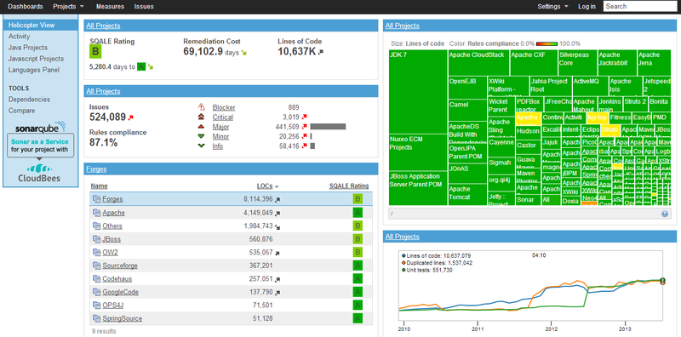

Slide 50
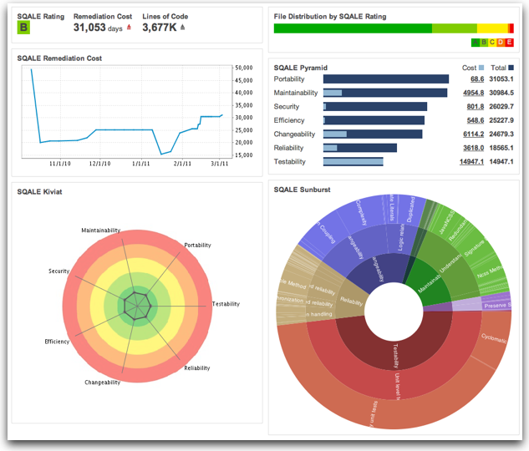

Slide 51
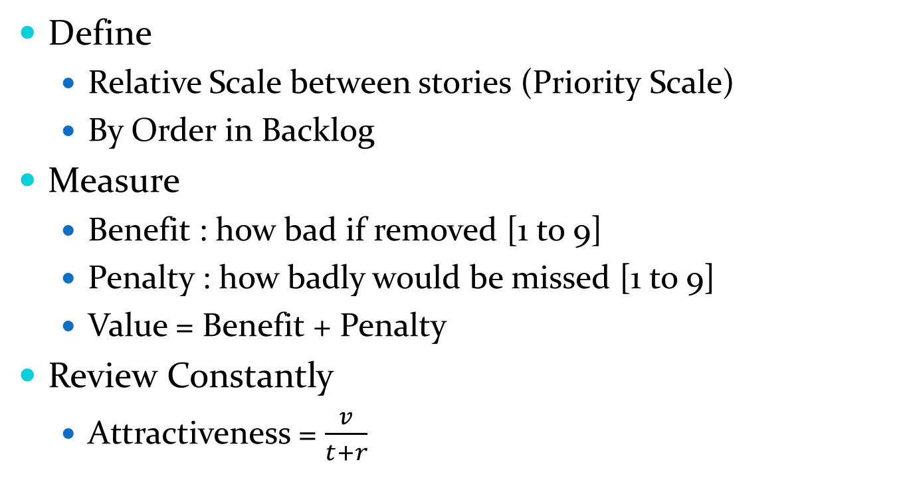
Dimensions in Agile : Value
Define
Relative Scale between stories (Priority Scale)
By Order in Backlog
Measure
Benefit : how bad if removed [1 to 9]
Penalty : how badly would be missed [1 to 9]
Value = Benefit + Penalty
Review Constantly
Attractiveness = $\frac{v}{t+r}$
Notes:
Attractiveness = v / (t + r) where v = Relative Value , t = Relative Size , r = Relative Risk
Relative Value = value of story / Sum value of Backlog
Relative Size = size of story / backlog size
Relative Risk = story’s risk / sum of backlog stories risk

Slide 52
Dimensions in Agile : Risk
Define
Risk Exposure = Probability x Loss
Loss = Money, Time or Story Points
Sources of Risk
Story, Release, Project, Software
Ex: Risk of Dependent Systems are incompatible during integration
People, Scope, Quality, Cost, Schedule
Ex: Risk of Team members dropping out
Ex: Risk of incorrect calculations affecting company billing
Measure
Size of Defects Backlog / Velocity (min)
Size of Stories Blocked by Impediments in Implements Backlog
Value of Stories Blocked by Impediments in Implements Backlog

Slide 53

The Product Owner (PO)
Controls the Product
Mediates between
Stakeholders and the Team
Stakeholders and Stakeholders
Enriches the Product in order to optimize the Return On Investment
The Gain / Cost / Time
The PO is not a project manager (PM). A product may need several different PM. The PO is the “teams custumer”
Notes:
http://pt.wikipedia.org/wiki/Retorno_sobre_investimento
http://en.wikipedia.org/wiki/Return_on_investment

Slide 54
Product Team
Is not the Dev Team. It’s the “arms” of the PO
May include business specialist and advisors
Focus on collecting information from stakeholders
Product Usability, FAQ, Suggestions, Features not used
Focus on measuring stories Value
Benefit, Penalty, Priority
Focus on getting the stories to “Ready” state
Focus on creating acceptance criteria
Corner Cases
Business Model consistency (interaction of rules)

Slide 55

Elicitation and Ready State
Stakeholders
Elicitation and Value Estimation
Product Backlog Grooming

Slide 56
Backlog Grooming
Add Story
Collect actors, objectives and acceptance
Remove Story
Log reasons for removal
Split Story
Transform one story in two or more stories
Merge Stories
Transform a collection of stories in a single story
Prioritize Story
Change relative story priority
Move story Between backlogs
From Product backlog to Release Backlog
From Release A to Release B

Slide 57

Size Estimation
Estimation
Product Backlog Gromming

Slide 58
Define Story Scale
Define Scale
Fixed
Discrete
Elicit Scope Size
From Team
Planning Poker
From Requirements
Points per ...
1
2
3
5
8
13
0
½
20
40
100
?
∞
π

Slide 59
Planning Poker
Repeat for each story
Product Owner explains story
Team members can ask questions to PO
Team members select size secretly
No Anchoring , No Dialog
Team members show selections simultaneously
If the same number is selected that is the story size
Else , members select size secretly again
Team members show selections simultaneously
If The same number is selected that is the story size
Else, members with higher and lower points explain selections. Resume point 2.

Slide 60
Estimate With Planning Poker
As a Hotel Guest I want to create a Reservation for a period of time. Receive confirmation by email
As an Hotel Clerk I want to list free Rooms in a range of dates, in order to create a VIP Reservation.
As an anonymous user I want to login providing my username and password.
As an anonymous hotel guest I want to create a login account, in order to manage my reservations.
As a hotel guest I want to access my room’s bill.

Slide 61
Preparing a Release
Define Goals for the release
Define Number of Sprints
This indirectly define schedule
Elicit stories that achieve the Goal
Put them in the Release Backlog
Estimate Size (if absent)
Estimate Value (if absent)
(Re)Prioritize
Move to next release if necessary
Move to backlog if no release can be defined
Adjust Goal(s) if necessary (resume 3)

Slide 62
Preparing a Sprint
PO Defines Goals for the Sprint
Team Defines Sprint Budget
Justifications can be offered
PO adds stories to sprint until budget is reached
Cannot explode budget
PO revisits stories goals and acceptance criteria
PO adds slack stories
2 or 3 points worth depending on sprint size and previous velocities
Notes:
If the stories have been in the backlog for too long is best to do a planning poker and estimate sizes. This is necessary even more so if 1SP = 1 Ideal Day

Slide 63
Sprint Budget
Consider Number of Team members
Consider Each members Allocation ( full time, part-time)
Team members can work in other projects
Consider vacations
Consider personal matters (1 day off to see the doctor)
Consider previous Velocity
Consider the velocity of previous sprints
Consider the variation of velocities
Do not consider using the best velocity (false optimism)

Slide 64
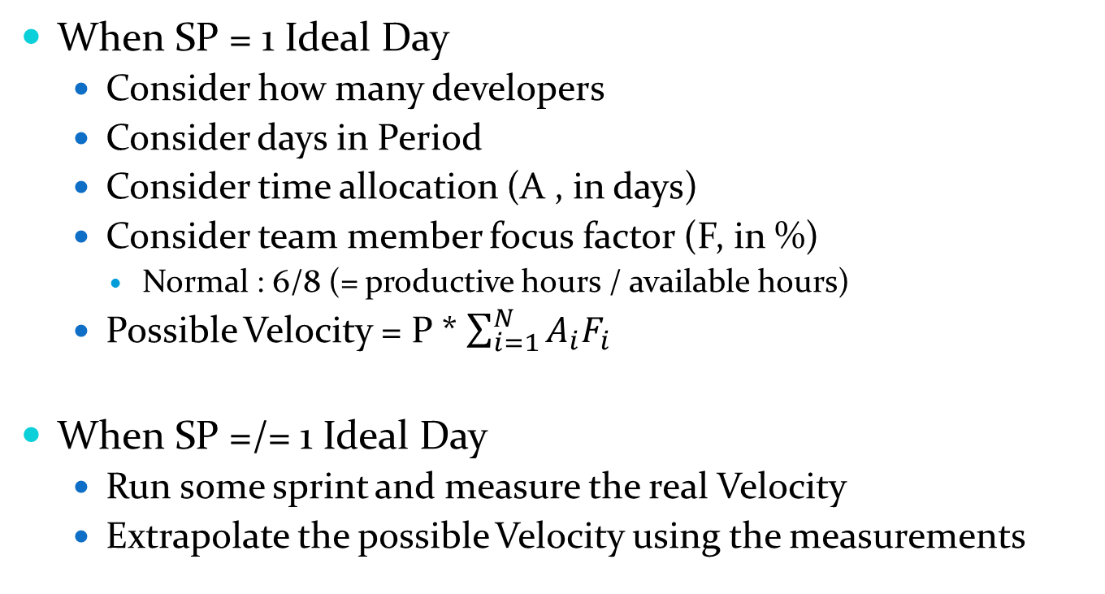
Estimate Possible Velocity/Budget
When SP = 1 Ideal Day
Consider how many developers
Consider days in Period
Consider time allocation (A , in days)
Consider team member focus factor (F, in %)
Normal : 6/8 (= productive hours / available hours)
Possible Velocity = P * $\sum_{i=1}^{N}{A_{i}F_{i}}$
When SP =/= 1 Ideal Day
Run some sprint and measure the real Velocity
Extrapolate the possible Velocity using the measurements

Slide 65
Velocity and Focus Factor
Sprint Velocity – Sum of Sizes of the Stories marked “Done” at the end of a sprint
Definition of “Done” is predefined before a sprint and influences the size of the story.
Sprint Budget – Quantity of Story Points the Team considers appropriated for the Sprint Backlog before it is defined
Normally the Velocity of previous Sprint
Sprint Factor of Focus = Velocity / Budget
Should be 100% or more.
Less than 75% represents severe impediments

Slide 66
Sprint Work Breakdown
Team members break stories in tasks
Each task containing a duration estimation in hours
Each task virtually assigned to a team member
Sum of all task durations initializes Burndown Chart
Sum all hours

Slide 67
Kanban Board (Execution)
Sprint Stories
Notes:
Kanban é japonês para “sinal” no sentido de “placa vísivel que significa algo”

Slide 68
Task Taxomony
What to do ?
Estimated time
Identification
S-123
200
5
T-123-3
16 h
As a hotel guest I want to reschedule my reservation, with no extra expense, in order to maintain interest in hotel services
Create web page
Acceptance
The Guest must be logged in It is not possible to reschedule for a past date
The Guest can only change his reservation
Denis
Assigned to

Slide 69
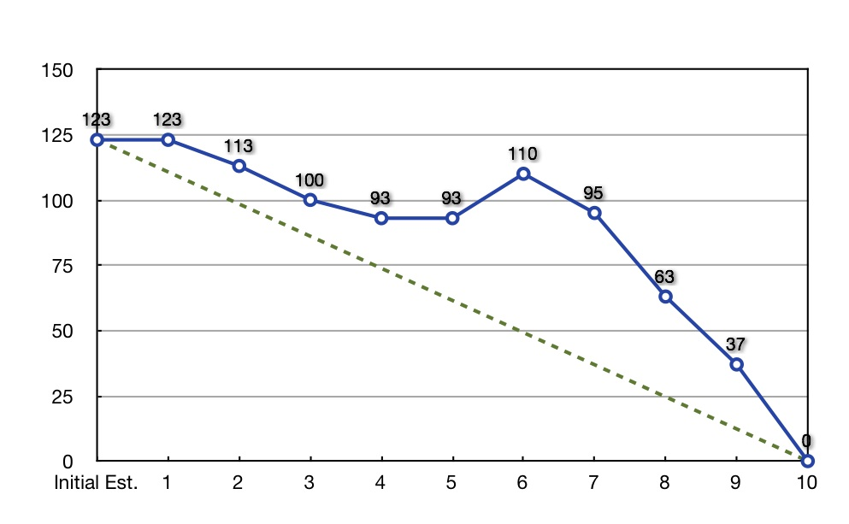
Burndown Chart (Execution)
Remaining Effort (hours)
Sprint Day (at end)
Notes:
The burn down should not go up. This is a symptom of something wrong in the process

Slide 70
Sprint Review
Teams shows software working
According to acceptance criteria
Team shows impediments
Product Owner marks stories as “Done”
The stories not done go back to the top of the backlog
Measure Velocity
Velocity = Sum of Size of Stories Done
Product Owner and Teams dialog about impediments
Impediments are put in the Impediments Backlog

Slide 71
Release Review
Product Owner and Stakeholders
Dialog about Impediments backlog, Defect Backlog and new Stories
Dialog about Sprint Velocity and estimations for future sprints and impacts on the Release
Some grooming will be necessary at this point
Establish stories for Sprint N+2
The next sprint should already be prepared
The Release Review should be one or more sprints ahead

Slide 72
Final Notes
Agile is Adaptive, but not instantaneously Adaptive
The time between when a story is created and implemented should be more that one sprint
Agile is not ad doc, go horse , cowboy style
Involves measuring and using measurements to decide
Measurements are often dynamic, on the spot or automated
Quality is the main drive of sustainability
Value must be delivered often, but that is not possible if defects take all the space in the backlog
Agile is not easy
PO must constantly communicate with Stakeholders, not only at the end of a sprint. The PO must be several step ahead of Team. Story supply must be permanent.
Team should be self-managed and that is a cultural challenge

Slide 73
References
Agile Estimation and Planning
Mike Cohn Boehm, Richard Turner, Prentice Hall
Balancing Agile and Discipline
Barry Boehm and Richard Turner – Addison-Wesley
Software Requirements
Karl E. Wiegers , Microsoft Press
Software Requirement Patterns
Stephen Withall, Microsoft Press
Agile Software Management with Scrum
Ken Schwaber, Microsoft Press
CHAOS Report
http://www.projectsmart.co.uk/docs/chaos-report.pdf
http://www.csus.edu/indiv/v/velianitis/161/ChaosReport.pdf
Agile Science
http://www.agilescience.org/

Slide 74
References
Principle of Least Astonishment
http://en.wikipedia.org/wiki/Principle_of_least_astonishment
The Clean Coder
Robert C. Martin et al, Prentice Hall
The Pragmmatic Programmer: From Journeyman to Master
Andrew Hunt, David Thomas, Addison-Wesley
What Does “Going Agile” Really Mean?
http://www.solutionsiq.com/resources/agileiq-blog/bid/58901/What-Does-Going-Agile-Really-Mean
Which Factors Affect Software Projects Maintenance Cost More? http://www.ncbi.nlm.nih.gov/pmc/articles/PMC3610582/
Agile Principles http://agilemanifesto.org/principles.html

